Slide 1

STUDY PROGRAMME PHARMACY
2018

Slide 2

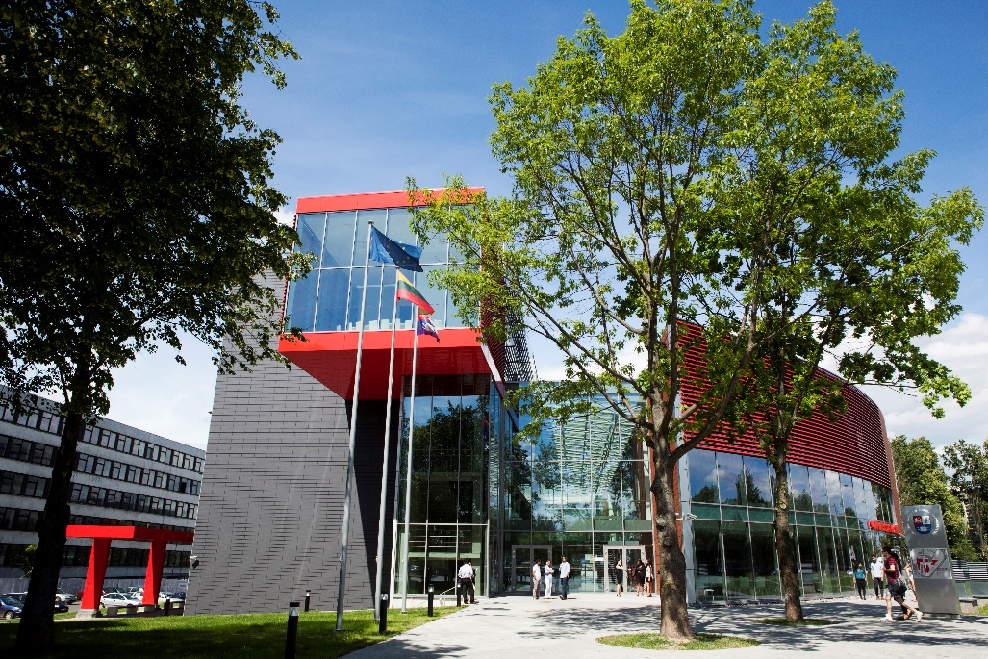
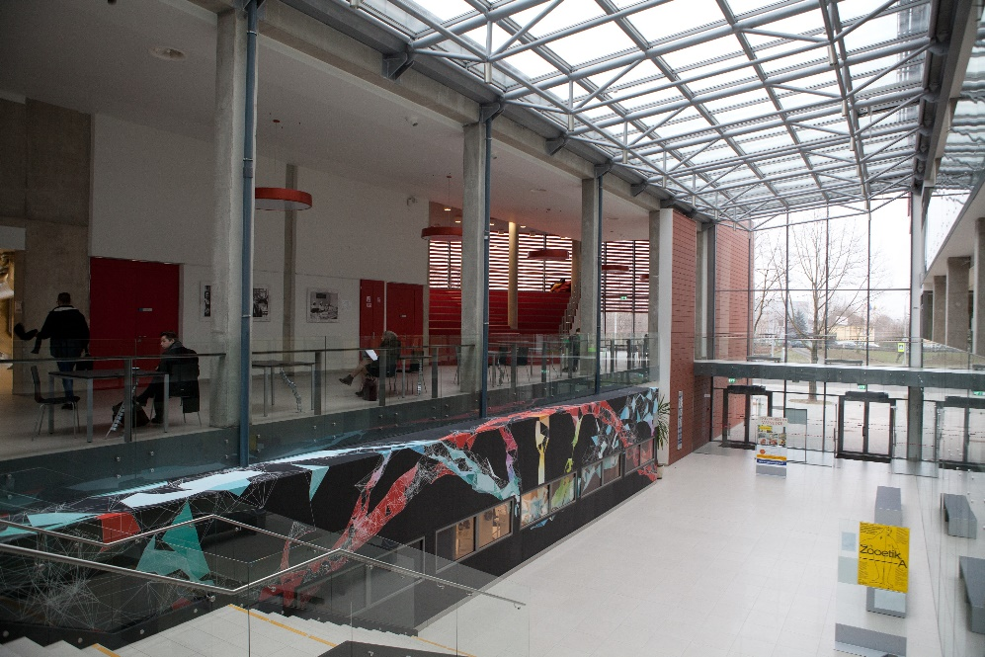
01 | FACULTY OF PHARMACY
MEDICAL ACADEMY
FACULTY OF PHARMACY:
The unit of science,
studies and bussiness
Long-lasting 100 years European traditions
Competent Academic staff
Relevant scientific research
Efficient practical training
Structure:
Department of Analytical and Toxicological Chemistry
Department of Pharmacognosy
Department of Clinical Pharmacy
Department of Drug Chemistry
Department of Drug Technology and Social Pharmacy
Institute of Pharmaceutical Technologies

Slide 3
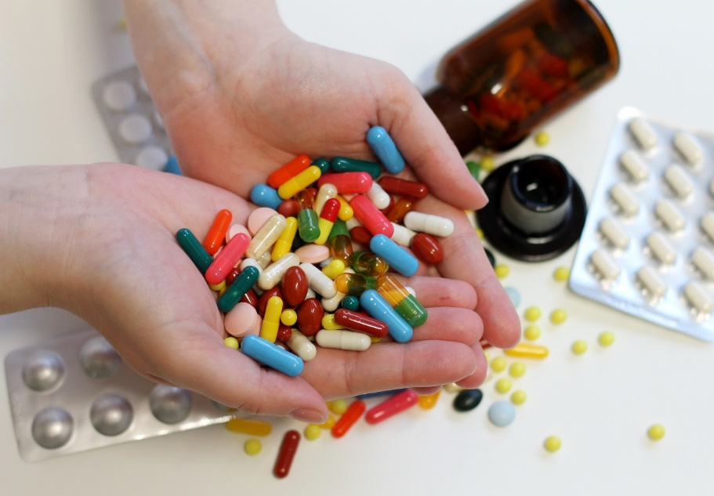
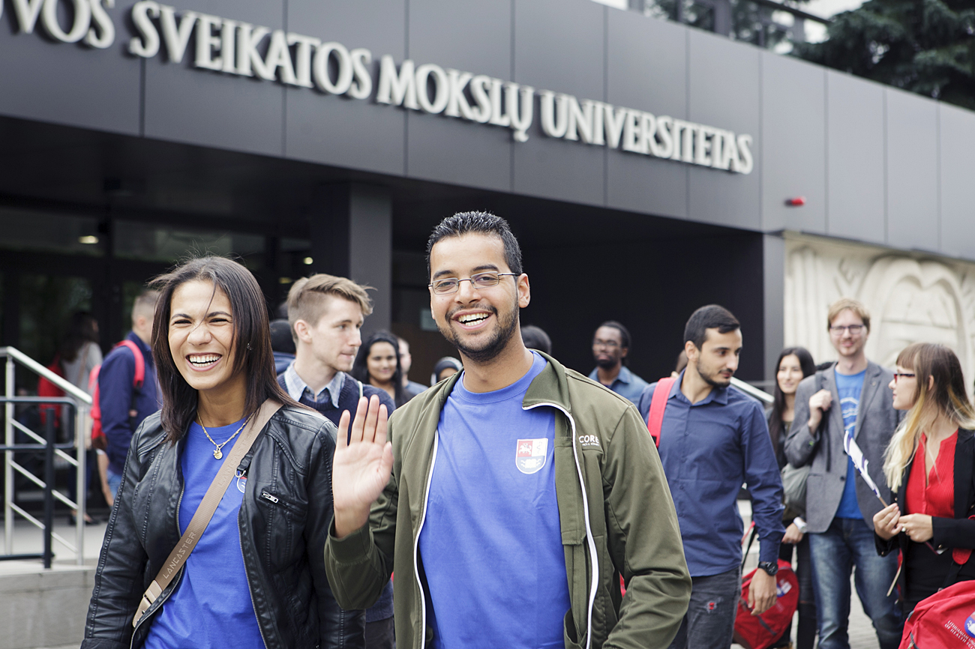
02 | PHARMACY PROGRAMME
PHARMACY
Field of studies Health sciences
Branch of studies Pharmacy
Duration in years 5 years 300 ECTS Full-time
Mode of study Integrated studies
Requirements for admission Secondary education
Annual Tuition Fee 6,000 EUR
Diploma
Master of Health Sciences /
Professional qualification of Pharmacist

Slide 4

03 | PHARMACY PROGRAMME
In 2017, full accreditation was extended for 6-years
Review team:
Damian Richard Day (team leader), Head of Education, General Pharmaceutical Council, United Kingdom;
Prof. dr. André RTS Araujo, Professor in Pharmacy, School of Health Sciences, Polytechnic of Guarda, Portugal;
Prof. dr. Borut Božič, Professor of Faculty of Pharmacy, University of Ljubljana, Slovenia;
Ms. Rasa Radžiūnienė, Product group manager of Sandoz Pharmaceuticals d.d., Branch office, Lithuania;
Ms. Vygailė Pundzaitė, student of Vytautas Magnus university study programme Biochemistry.

Slide 5
04 | PHARMACY PROGRAMME
The program conforms to European and national requirements, and it is designed according to:
European Directive for regulated profession (2005/36EC and 2013/55EC);
The Order of Research and study of the Republic of Lithuania;
Regarding approval of General requirements for integrated and degree conferring first level study programmes;
Regulations of EHEA, defined in Bologna process for integrated study;
Pharmacy field descriptor, full time 5-yr integrated study programmes leading to a qualification, degree of Master of Pharmacy.

Slide 6
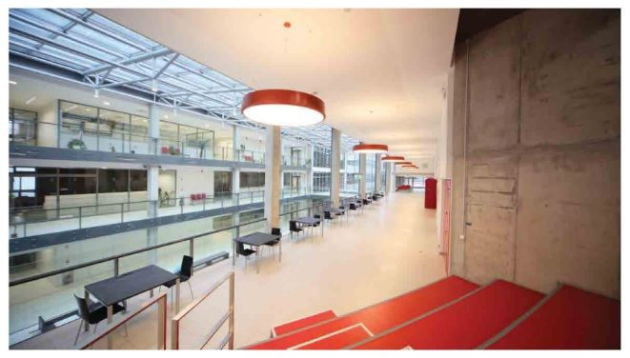
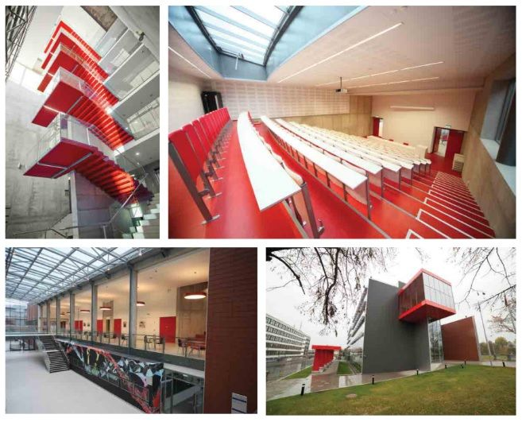
05 | PHARMACY PROGRAMME
Objectives of Pharmacy Faculty
To ensure the compliance of the Pharmacy study programme with the European Union (EU) requirements;
To pursue the accessibility of pharmacy studies to young people, healthcare specialists, and other related professionals;
Broadly integrate the Pharmacy study and research activities in the pharmacy field;
To educate highly qualified pharmacy specialists applying modern information technologies, effective teaching and learning methods.
To participate in scientific research in the field of pharmacy;
To participate in formation and implementation of healthcare policy and strategy

Slide 7
06 | PHARMACY PROGRAMME
STRUCTURE OF PROGRAMME
YEAR 1
YEAR 4
YEAR 1
Biology, Mathematics, Physics, Anatomy, Physiology and Patophysiology, Botany, Inorganic Chemistry, Lithuanian Language
YEAR 2
Pharmaceutical analysis, Organic Chemistry, Biological Chemistry, Microbiology, Basics of Health Care
YEAR 3
Pharmaceutical Technologies, Pharmacognosy, Pharmaceutical Chemistry, Pharmacology, Biopharmaceutics, Essentials of Internal Diseases, Pharmaceutical Marketing
YEAR 4
Drug Chemistry, Toxicology, Clinical Pharmacy and Pharmacotherapy, Pharmaceutical Biotechnology, Social Pharmacy
YEAR 5
Pharmaceutical Care, Development of Pharmaceutical Products, Pharmaceutical Economy, Practical training at public and hospital pharmacies
YEAR 2
YEAR 5
YEAR 3

Slide 8

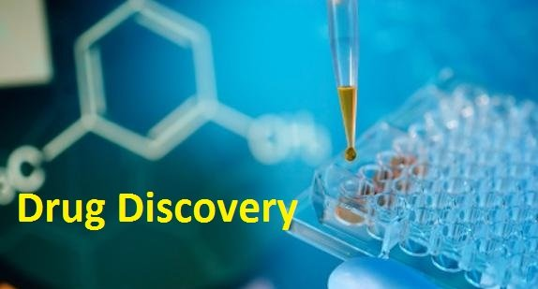
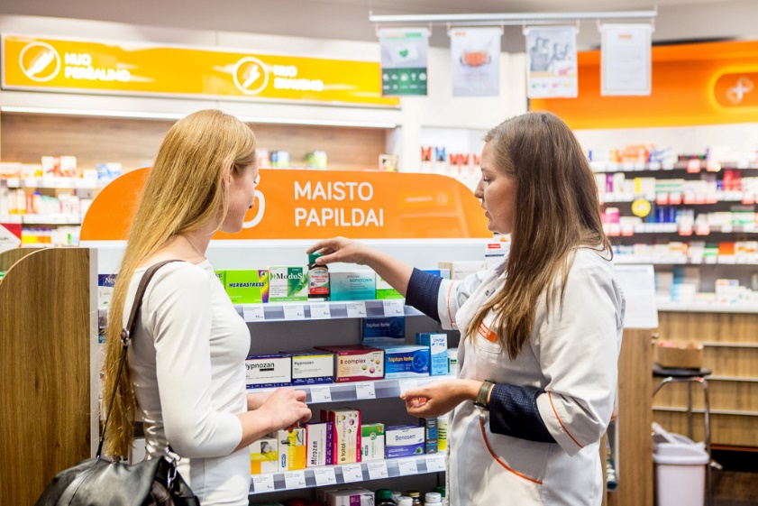
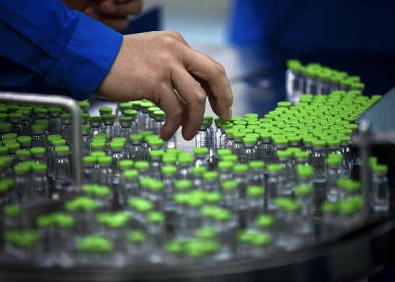

07 | PHARMACY PROGRAMME
AFTER GRADUATION YOU CAN BE EMPLOYED
at pharmaceutical wholesale companies
at laboratories of biomedical and pharmaceutical research
at pharmacies
at companies of the pharmaceutical industry
continue your education by entering PhD programmes

Slide 9
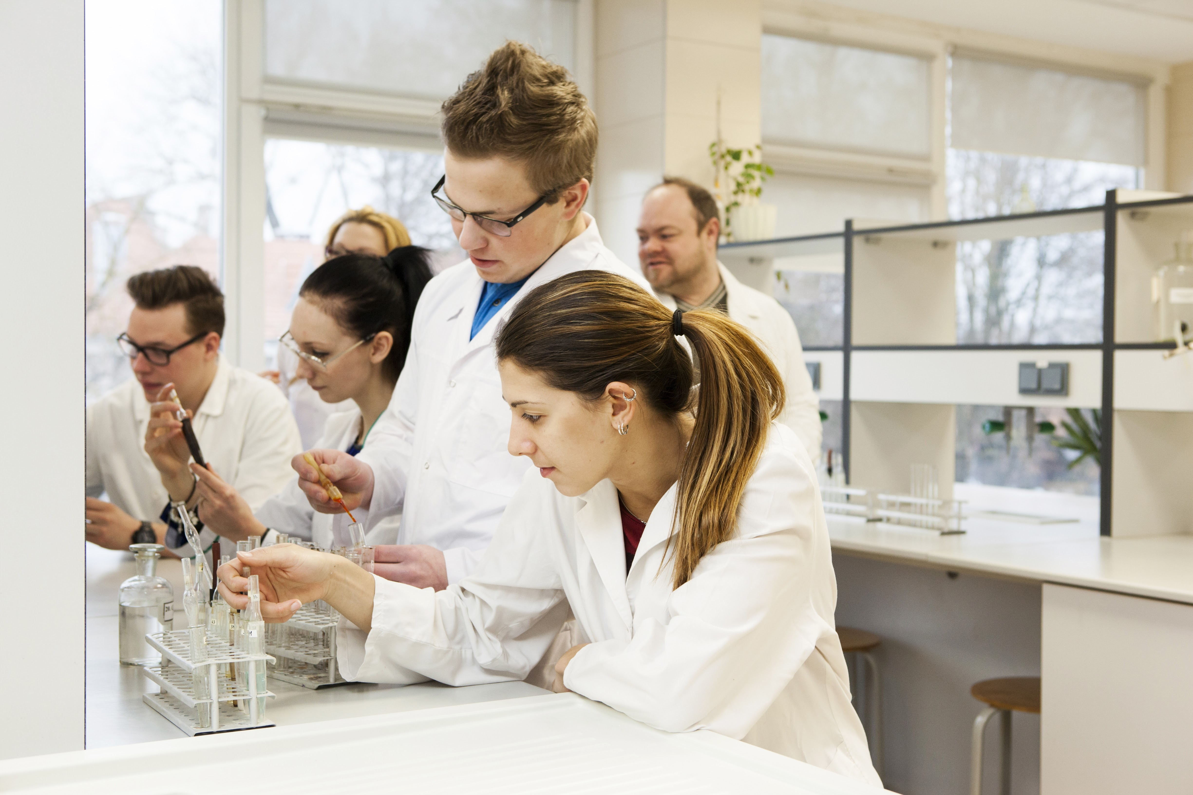
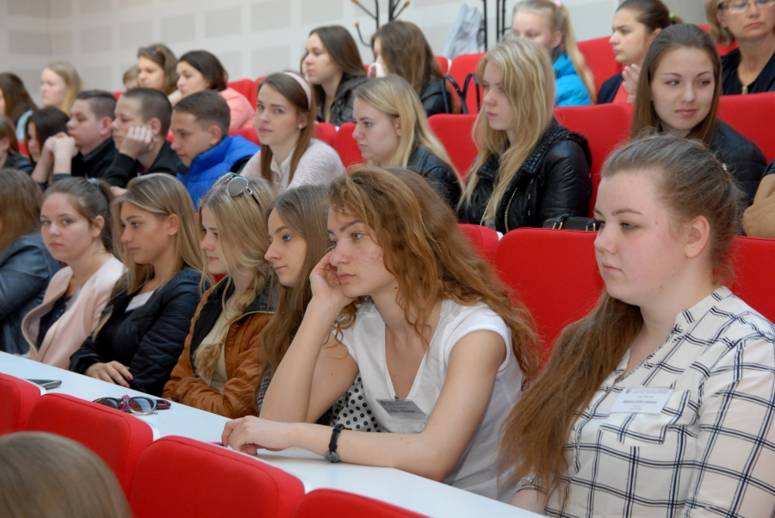
08 | PHARMACY PROGRAMME
A WIDE SPECTRUM OF TEACHING METHODS
Lectures (the whole class or half classes),
Presentations,
Discussions in small groups,
Crossover learning
Context based learning
Laboratory practice,
Balance between the theory and practice (after every theoretical session there is a related practical class).
The number of students in groups in pharmacy is 12.

Slide 10
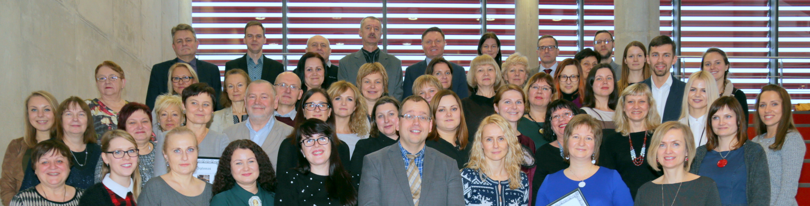
09 | PHARMACY PROGRAMME
TEACHING STAFF
Professors and associate professors make approximately 59 % of total number of academic staff.
All teachers have obtained PhD degree.
Lecturers from other Lithuanian and/or foreign higher education institutions contribute to the programme on an occasional basis.
Experienced staff act as Master’s thesis supervisors. Master’s thesis supervisors have doctoral degrees and practical experience in the fields of the subjects they teach.

Slide 11
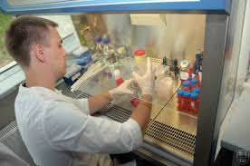

10 | PHARMACY PROGRAMME
RESEARCH
Phytochemical investigation of medicinal herbs and search for biologically active substances.
Development of pharmaceutical technologies and research into innovative drug delivery systems for efficient delivery of drugs.
Optimisation and development of methods of pharmaceutical analysis, forensic expertise and chemical express diagnosis in acute intoxications with drugs.
Research into clinical and social aspects of pharmacy to ensure safe and efficient use of medicinal preparations.

Slide 12
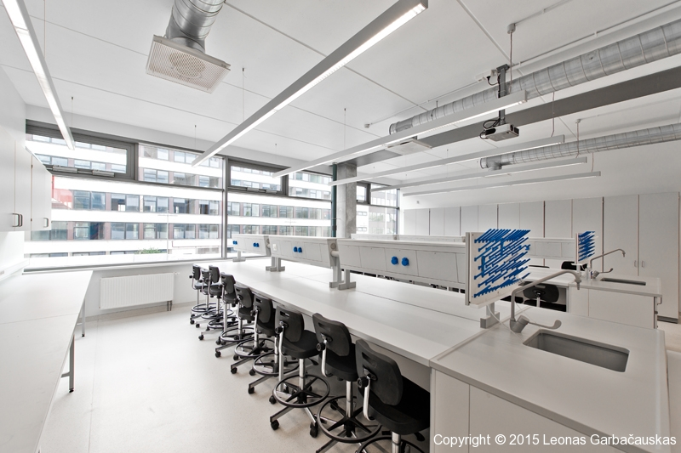
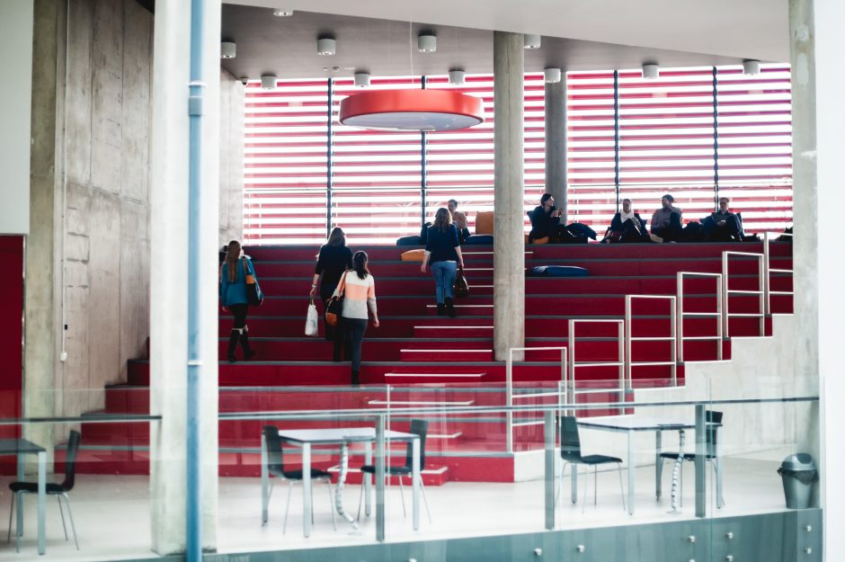
11 | PHARMACY PROGRAMME
FACILITIES AND LEARNING RESOURCES
The programme is located in a new building (built in 2014) with modern facilities, including space for different activities like lectures, seminars, laboratory work, student recreation areas and personal study areas
Laboratories have excellent equipment for students, allowed their research work across a wide spectrum of activities like formulations, dosage form, stability and dissolution.
LSMU’s on-site pharmacy which has good manufacturing practice facilities.
Pharmacy history teaching takes place in the institution’s pharmaceutical museum, which is in the centre of Kaunas and open to the public.

Slide 13
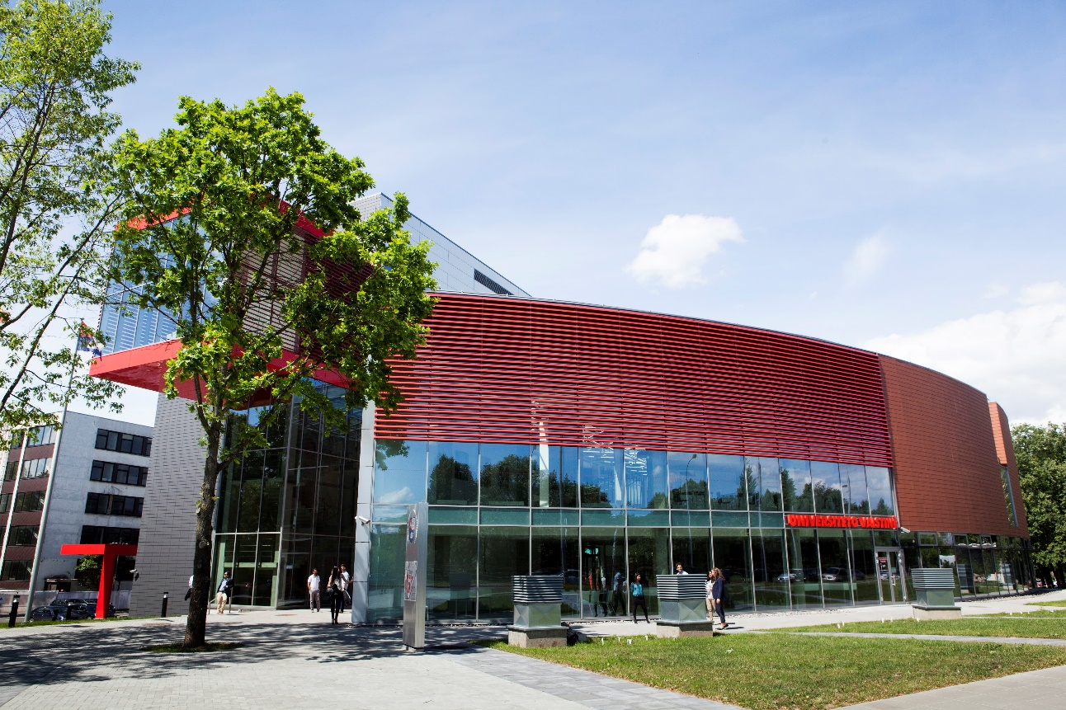
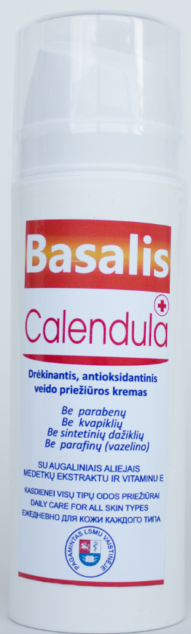
12 | UNIVERSITY PHARMACY
UNIVERSITY PHARMACY
Fifth-year pharmacy students develop their first practical skills in our own pharmacy.
Pharmacy specialists produce individual composition of prescription medicine for patients, traditional medicine and homeopathic preparations.
Pharmacy operates medical cosmetic products of industrial production line

Slide 14
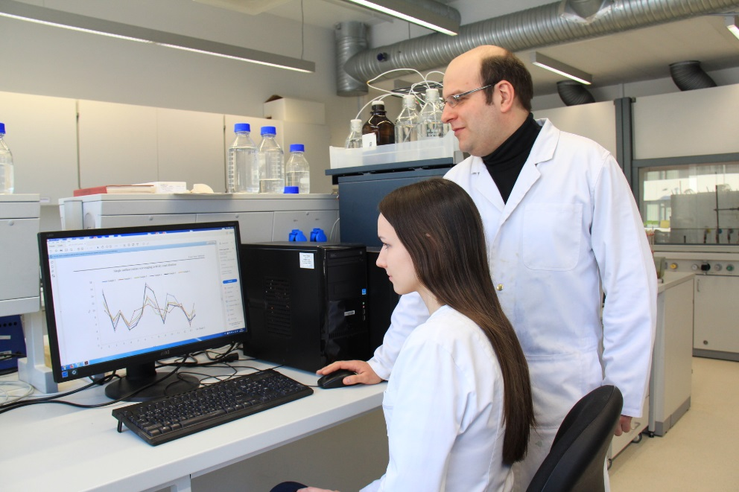
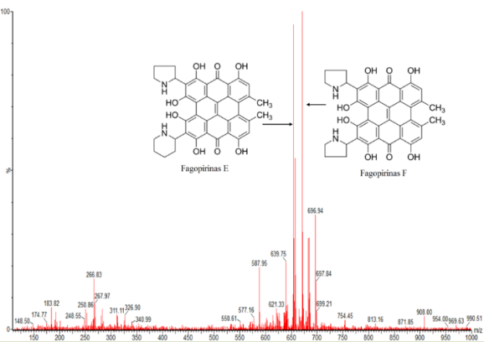
13 | PHARMACY PROGRAMME
STUDENTS OF FACULTY OF PHARMACY CAN
Acquire skills on modern selective and informative analysis methods:
High-performance liquid chromatography,
Post column derivatisation assays,
Tandem-mass spectrometry detection
Gas - chromatography
Stability and uniformity indicating methodologies;
Purity investigation of various pharma products.
Analytical fingerprinting and chemometrics for the qualitative and quantitative determinations of the phytochemicals in medicinal plants

Slide 15
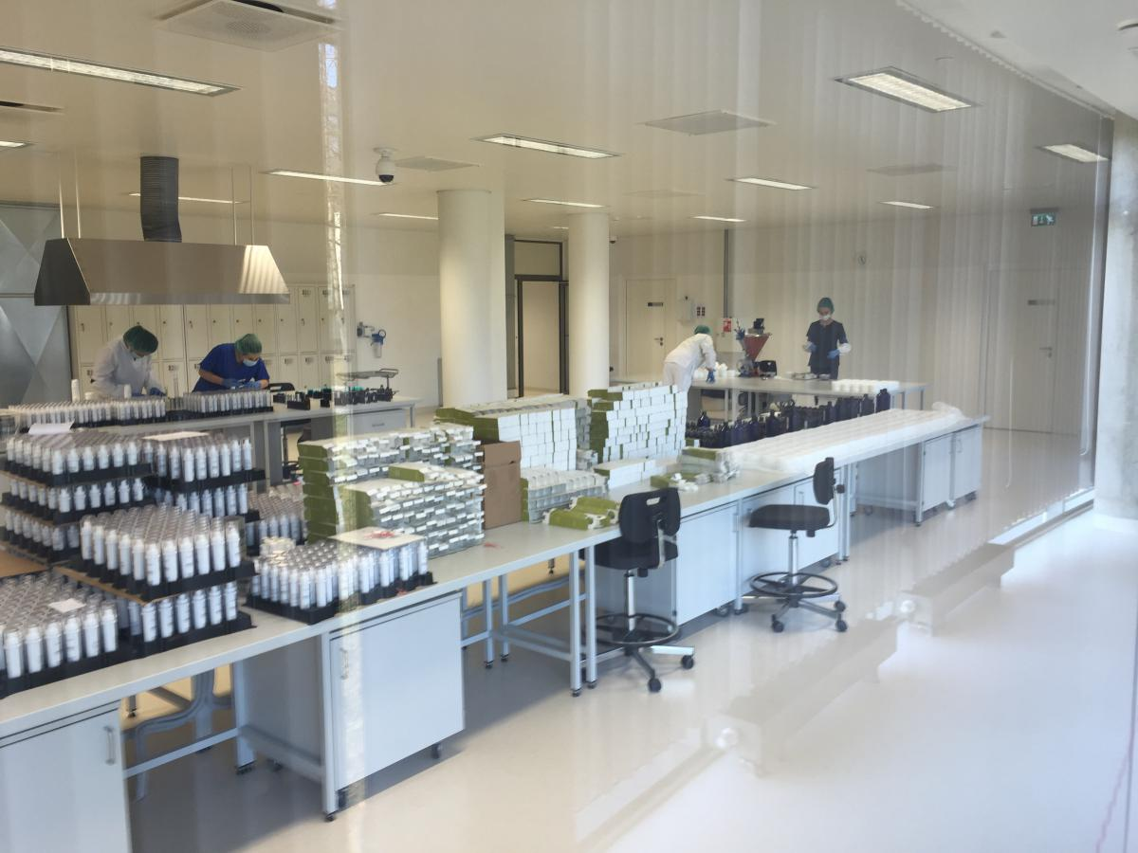
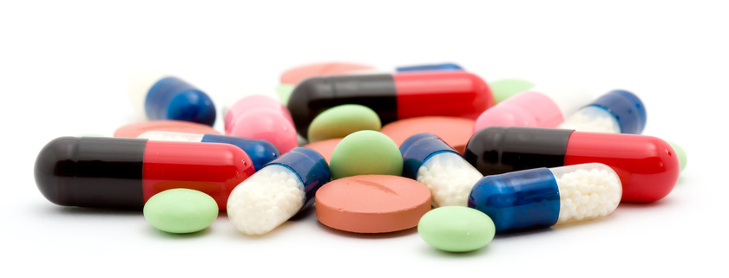
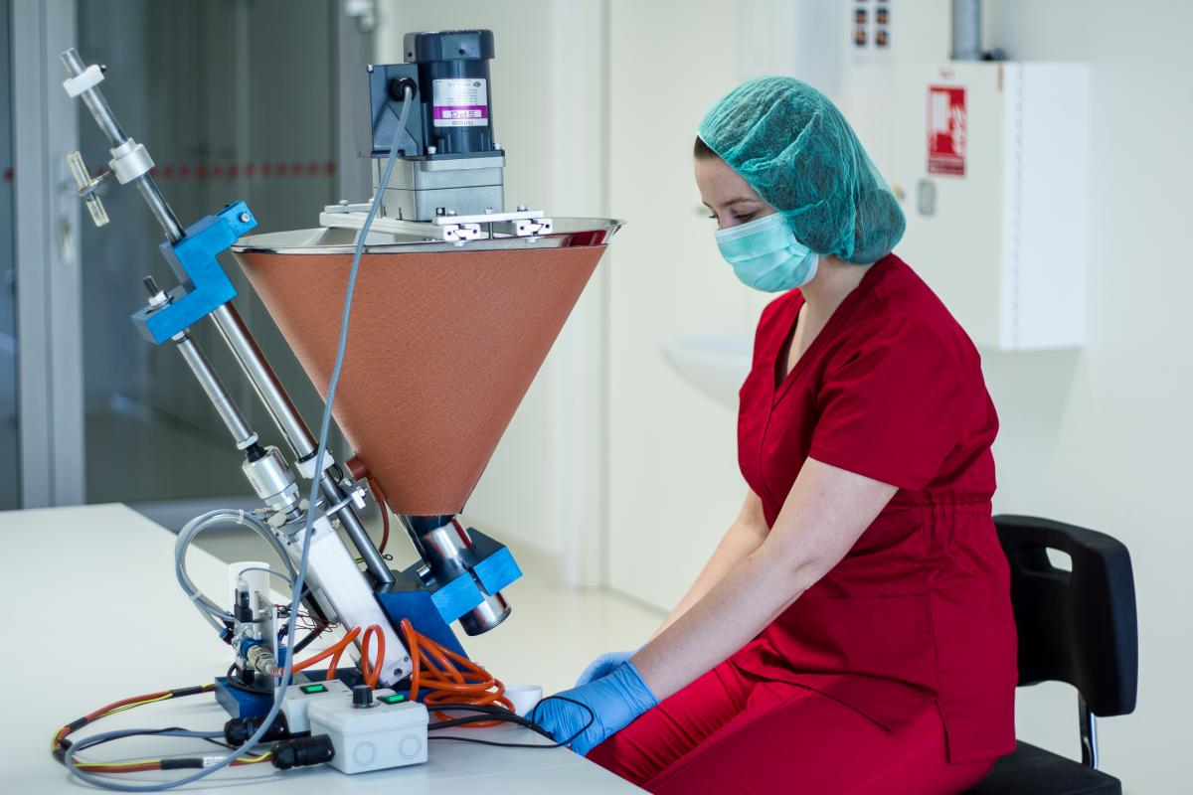
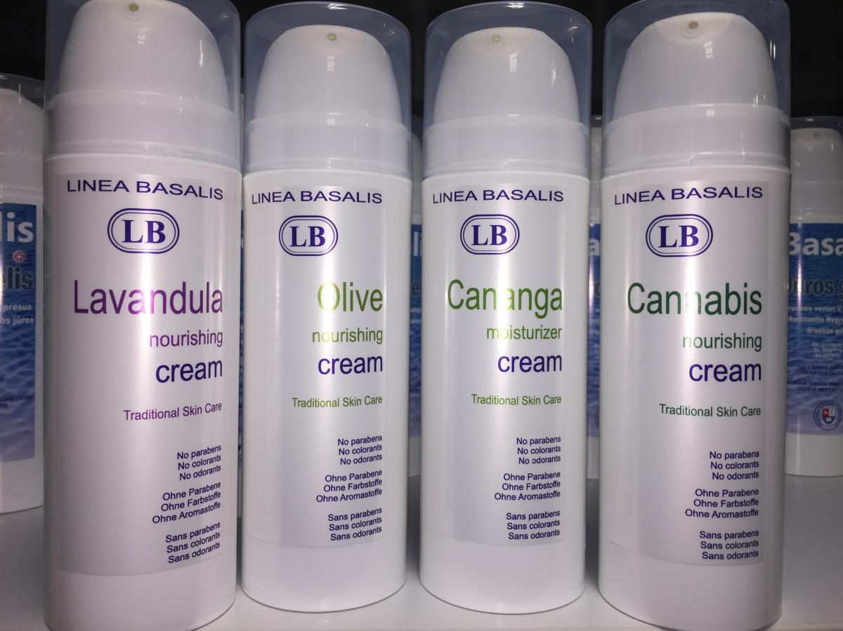
14 | PHARMACY PROGRAMME
STUDENTS OF FACULTY OF PHARMACY CAN
Participate in development of innovative products:
capsules,
microcapsules,
suppositories,
tablets,
skin care products.

Slide 16
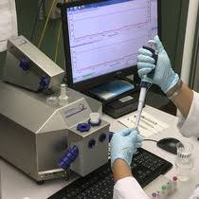
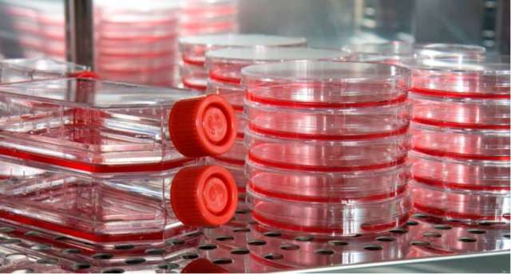
15 | PHARMACY PROGRAMME
STUDENTS OF FACULTY OF PHARMACY CAN
Involve preclinical testing of drugs and medicines
Various cell culture models using fluorescence microscopy,
Isolated mitochondria assays using high resolution respirometer Oroboros O2K Oxygraph system
Permeability of drugs through biological membranes: modeling and in vitro / in vivo studies.
Biopharmaceutical evaluation of semi-solid and solid dosage forms

Slide 17
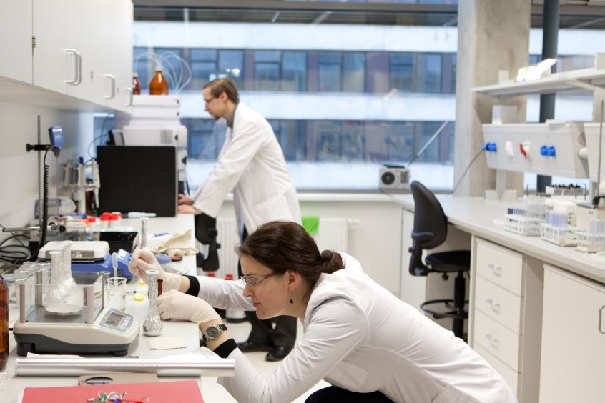
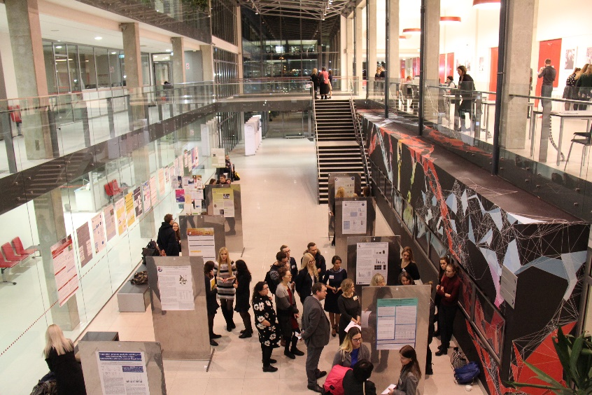
16 | PHARMACY PROGRAMME
WHY STUDY PHARMACY AT LUHS?
Diploma recognized in EU, USA, Israel and other countries
Practical skills developed in the brand new laboratories of the Faculty of Pharmacy with up-to-date equipment
Possibility to participate in various research projects
Possibility to spend a semester or a year abroad with the Erasmus+ exchange programme

Slide 18
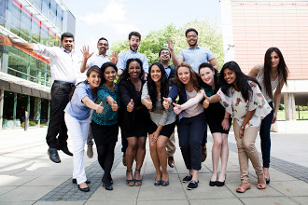
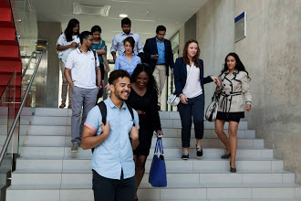
17 | PHARMACY PROGRAMME
WHY STUDY PHARMACY AT LUHS?
Multicultural environment and student community: international students from 48 different countries make up nearly 10% of the total student population at LUHS
Support system for students’ adaptation: mentoring, tutoring and psychological counselling
Pharmacy Student Society
International coordinator of Faculty of Pharmacy

Slide 19
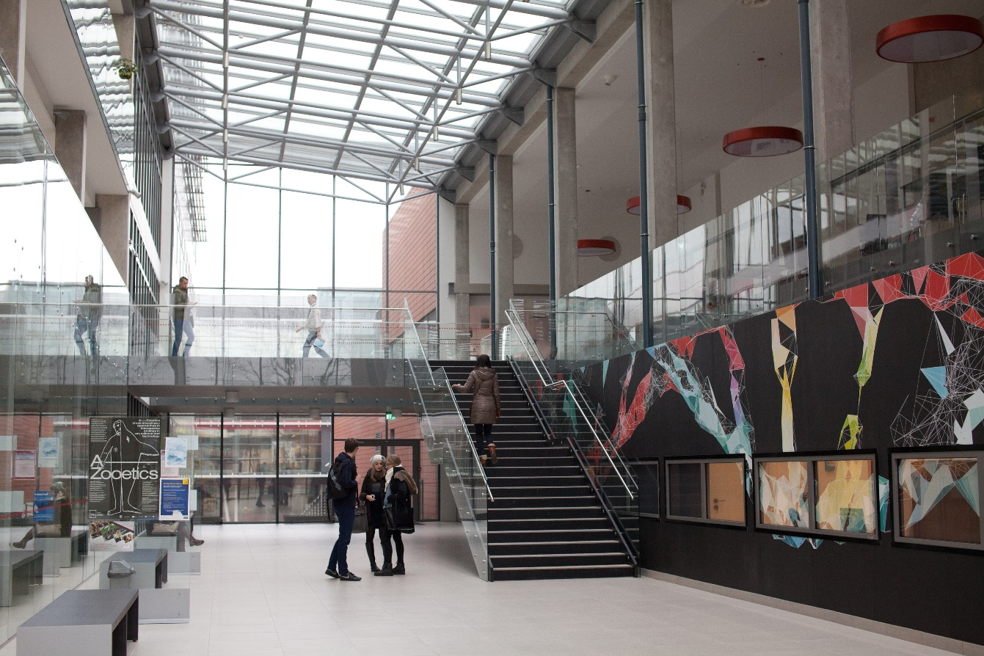
18 | PHARMACY PROGRAMME
QUALITY OF PHARMACY PROGRAMME
Lithuania is a member the European Association for Quality Assurance
in Higher Education (ENQA).
Student oriented study process.
Students and social partners’ participation in decision-making.
Feedback and continuous quality improvement.

Slide 20
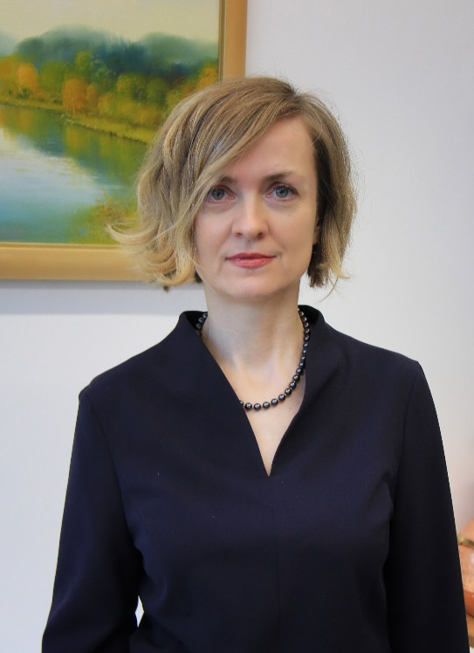
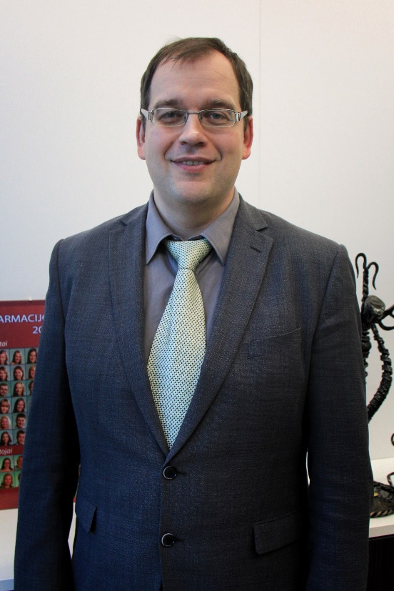
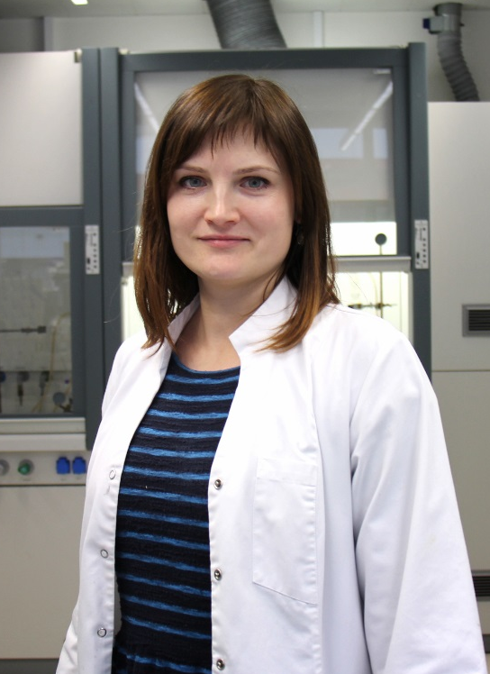
19| CONTACTS OF FACULTY OF PHARMACY
Sukilėlu avenue 13, LT-50162 Kaunas
Phone: 00 370 37 327248,
E-mail: farmacijos.dekanatas@lsmuni.lt
CONTACTS OF DEAN‘S OFFICE
Prof. Ramunė Morkūnienė
Dean
Phone: 00 370 37 327248
E-mail: ramune.morkuniene@lsmuni.lt
Prof. Valdas Jakštas
Vice-Dean
Phone: 00 370 37 327249
E-mail: valdas.jakstas@lsmuni.lt
Assoc. Prof. Lina Raudone
International Study Coordinator
Phone: 00 370 37 327248
E-mail: lina.raudone@lsmuni.lt

